Slide 1
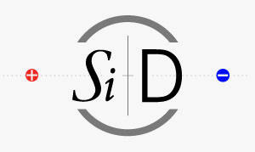

EMCAL RESOLUTION STUDIES AND UPDATE
Jason Barkeloo
J. Brau, A. Steinhebel, E. Meyer, J. Carlson
University of Oregon

Slide 2
OUTLINE
KPiX
Reminder of What Has Been Done
Where I started on the project
Test Beam Simulation and Comparison to KPiX data
How we start applying these to the full detector model
Current Geometry Studies
Effects on Resolution
Beginning to Look at Simulated Events

Slide 3
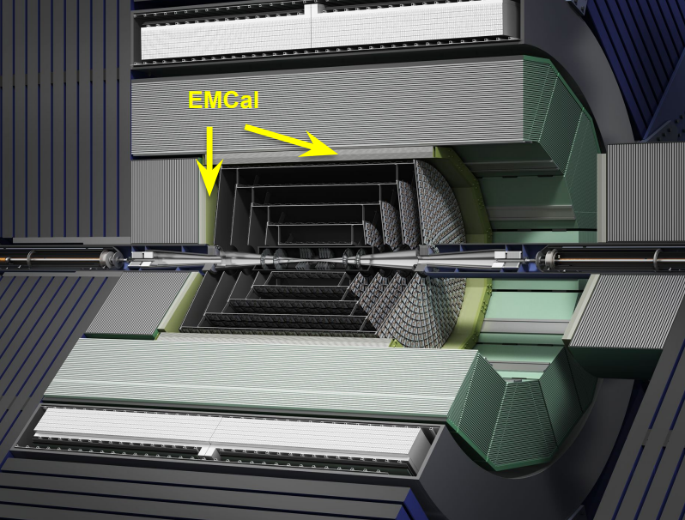
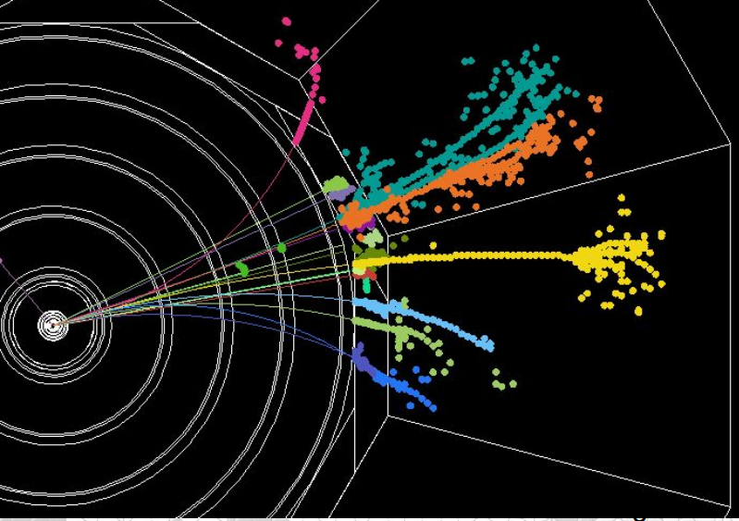
PARTICLE FLOW CALORIMETRY
SiD has been designed to use Particle Flow Calorimetry to measure all final states with precision
We expect excellent jet energy resolution
Measure charged momenta with tracker, neutral energies with calorimeters
Requires very fine segmentation
An “Imaging ECAL” is a crucial part of the design
Silicon-Tungsten based calorimeter is being developed for a high granularity ECAL
KPiX ASIC for readout of silicon pixels

Slide 4
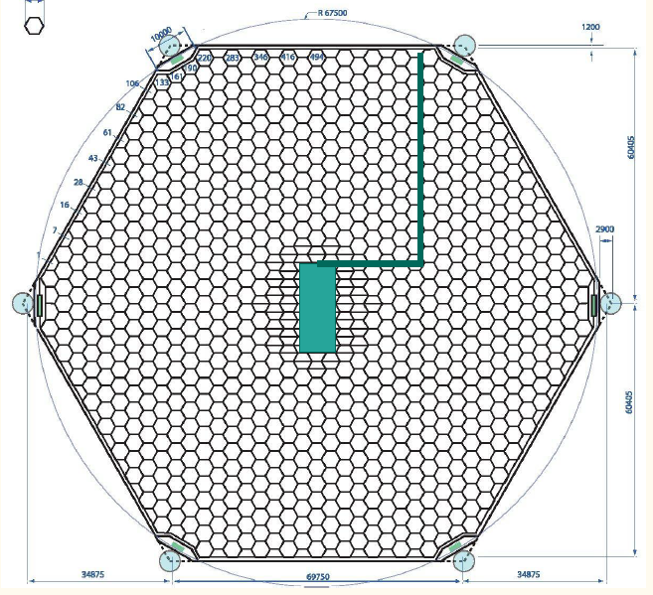
KPIX
6 inch wafers
1024 13mm² pixels
Readout and cable are bump-bonded directly to the sensor
Test beam studies have happened with an initial version of this KPiX sensor design
Will come back to the geometry and its effect on resolution measurements

Slide 5
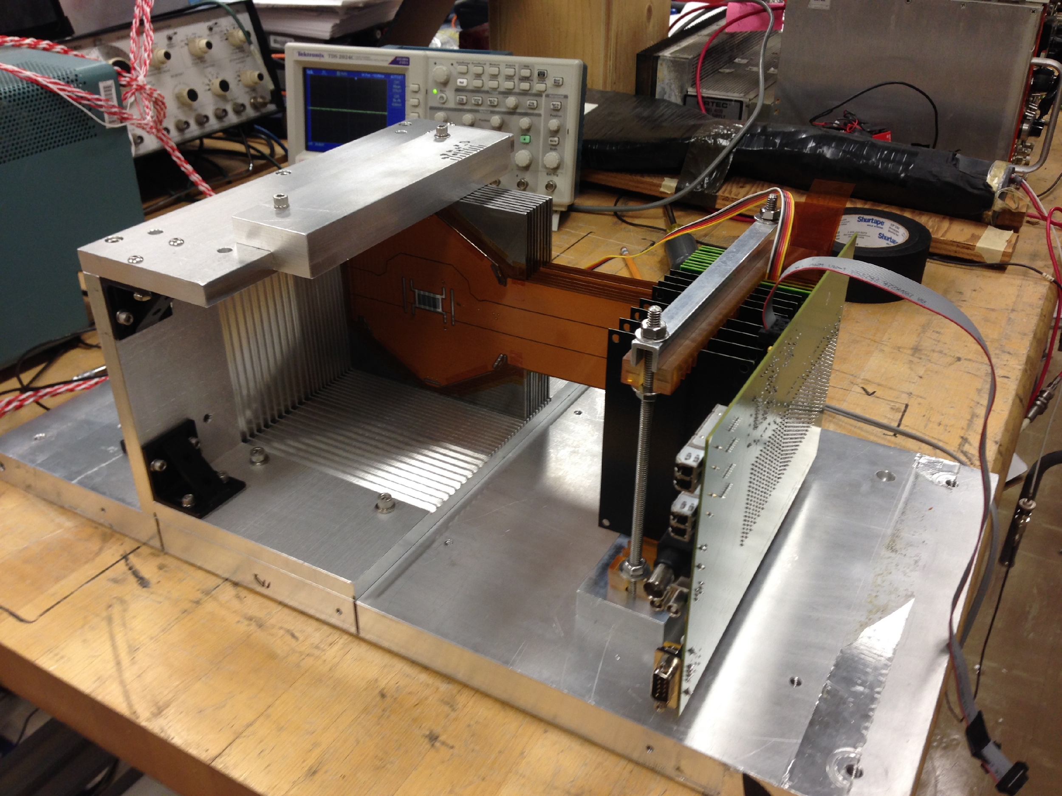
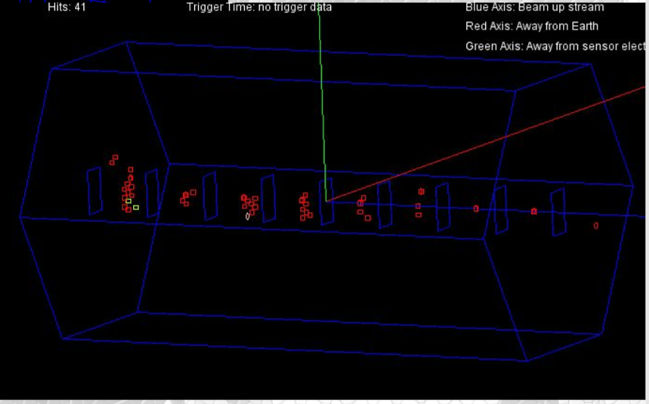
TEST BEAM STUDIES
Small 9 layer stack was placed into SLAC test beam
Sensor issues have been found and change the design going forward
Cross Talk, Dead Pixels, …
Many electron events were seen that we can analyze and compare with simulation to improve understanding of the system
Resolution, Identification (how well we can tell how many electrons are in an event)

Slide 6
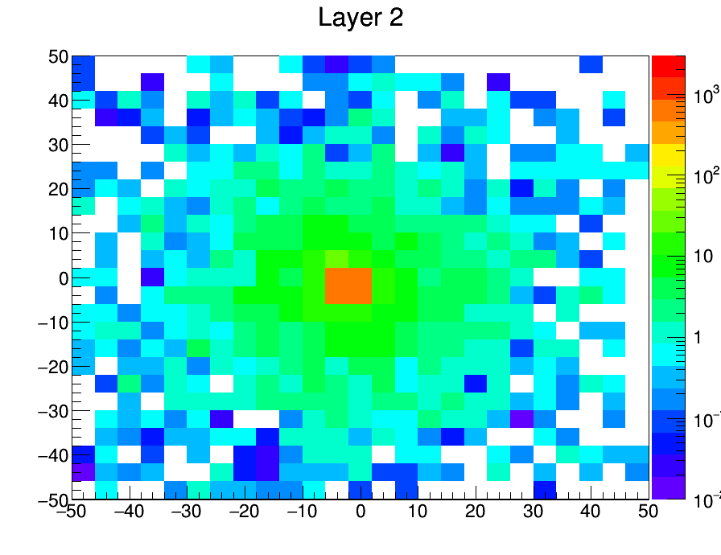
TEST BEAM STUDIES GEANT4 COMPARISON TO DATA
Geant4 Simulation created of 40x40cm plane of alternating Si (320 μm) and W (2.5mm,5/7 χ₀ )
40 (thin W) layer detector simulated simulated, only include 9 to match test beam stack for comparisons sake
Electrons fired at origin of various energies (in particular 12.1 GeV, test beam energy)
Want to try to match test beam running conditions
1000events, 10GeV, 4mmx4mm ‘pixels’. Energy inMeV deposited (all events summed) on the z-axis.

Slide 7
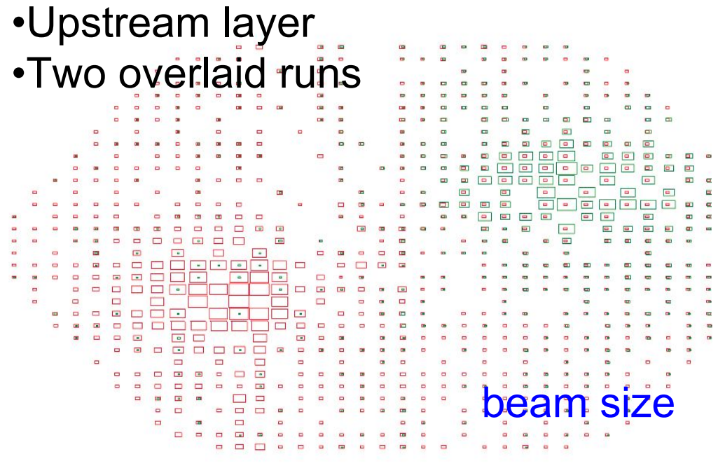
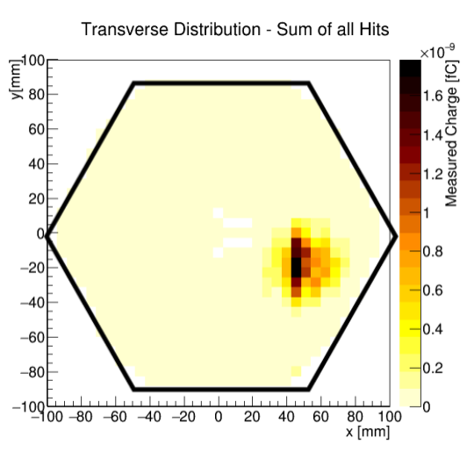
COMPARISONS (CONT.)
Attempted to model distribution of electron multiplicity and errors in test beam
10% pixels randomly removed from each layer
Poisson distribution of simultaneous electrons per event used <n>=0.8725
Shifted from central area (more densely pixelated, also test beam was shifted away)
Match hit to KPiX pixel location

Slide 8
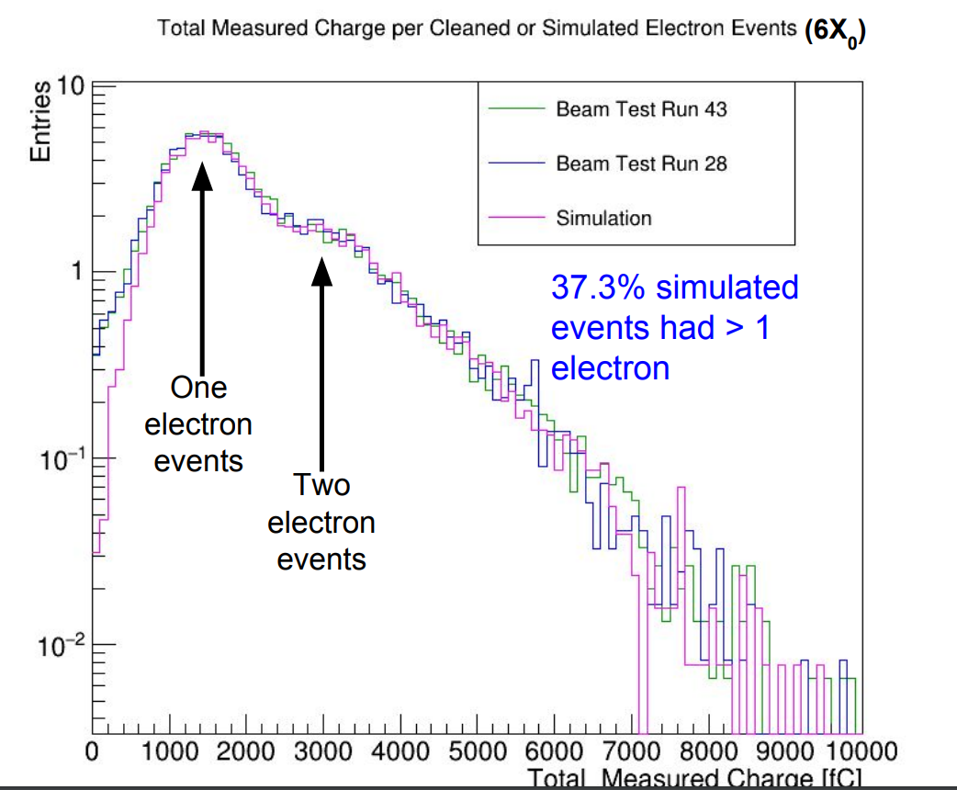
COMPARISONS (CONT.)
Excellent agreement to test beam data.
Couldn’t remove all of the low E shoulder during test beam cleaning (lots of ~0fC hits)

Slide 9
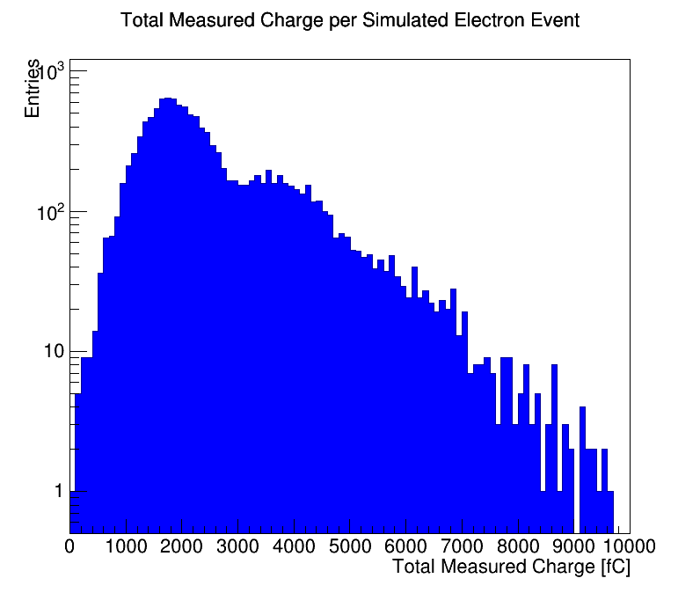
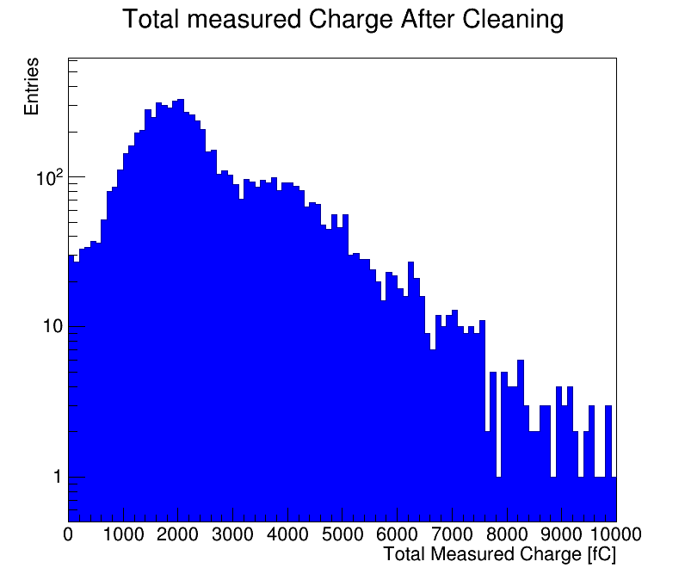
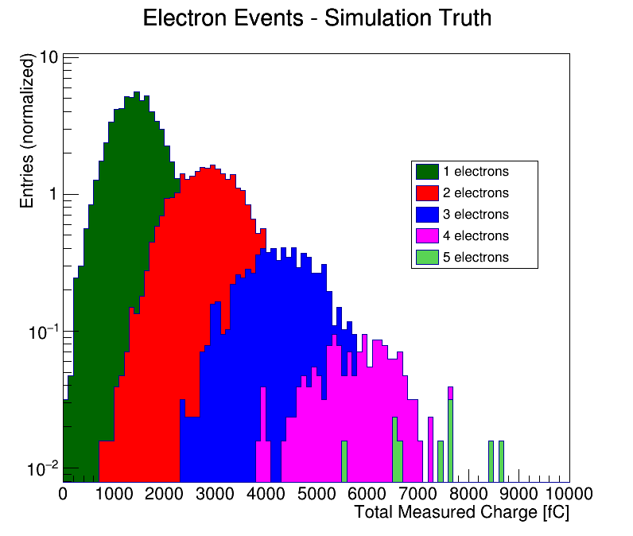
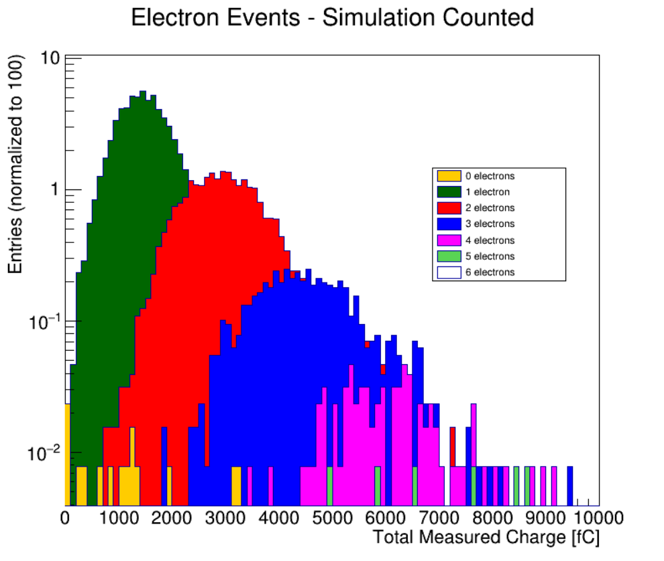
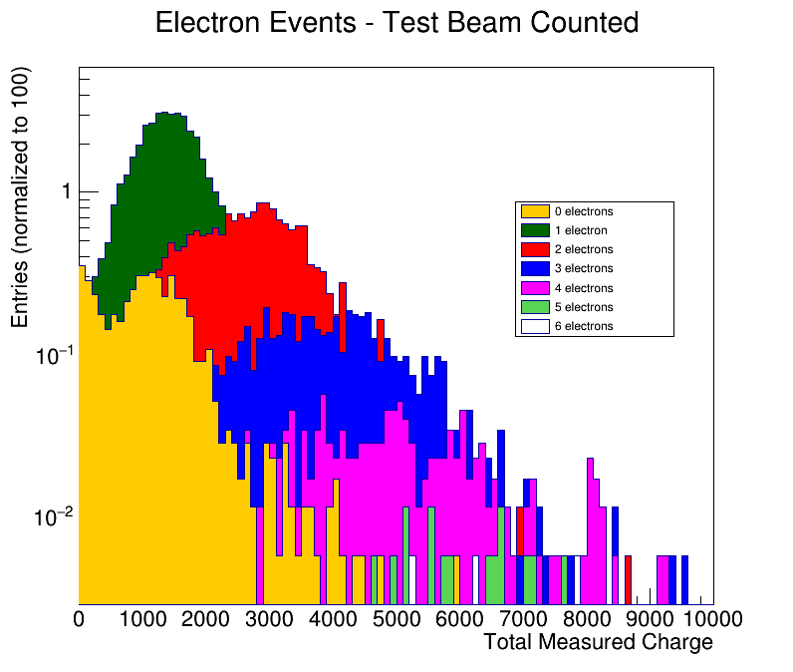
COUNTING ELECTRONS
Algorithm used to count the number of electrons in the even based on energy distributions throughout the detector.

Slide 10
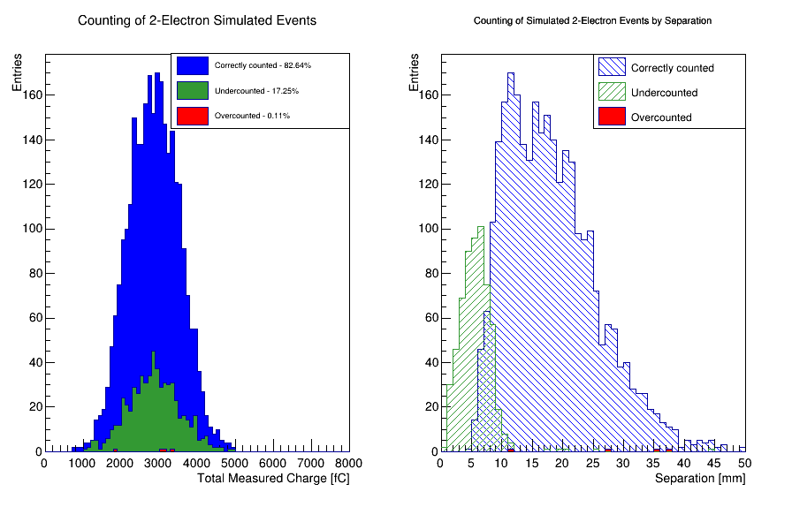
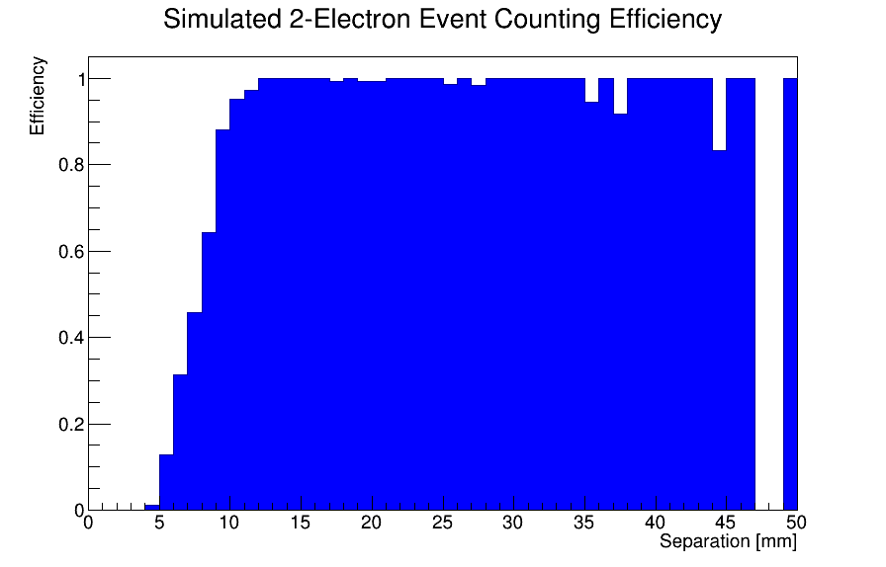
COUNTING ELECTRONS (CONT.)
No field, just simple detector simulation

Slide 11
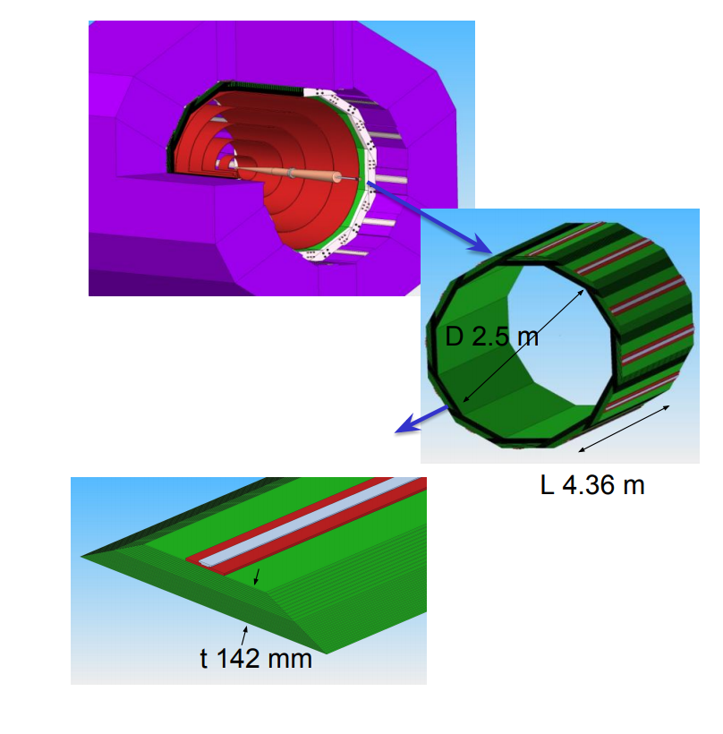
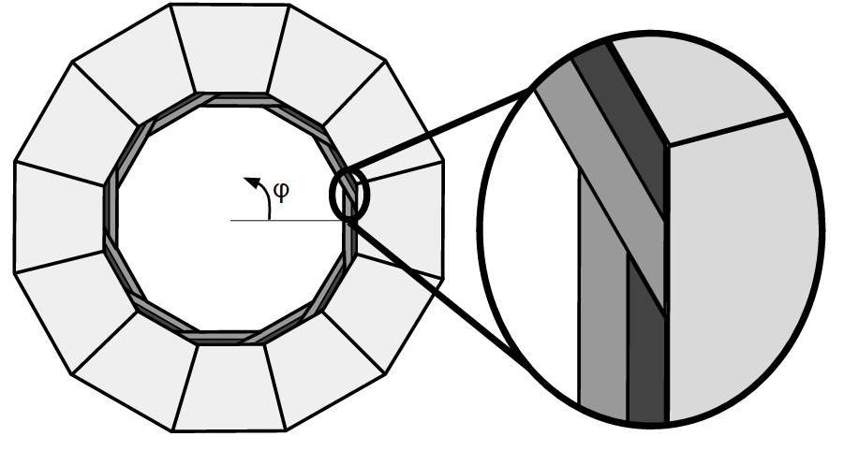
ECAL GEOMETRY AND ITS EFFECTS
20 layers 2.5mm W
10 layers 5mm W
30 gaps 1.25mm w/pixel sensors
29 χ ₀

Slide 12
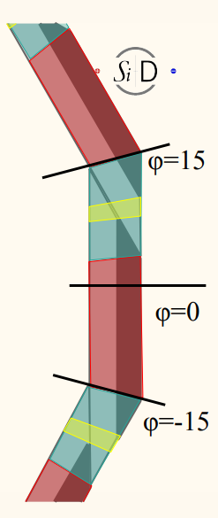
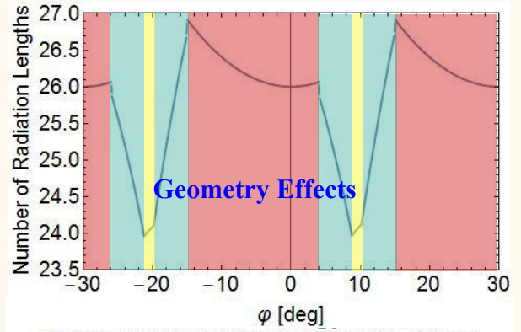
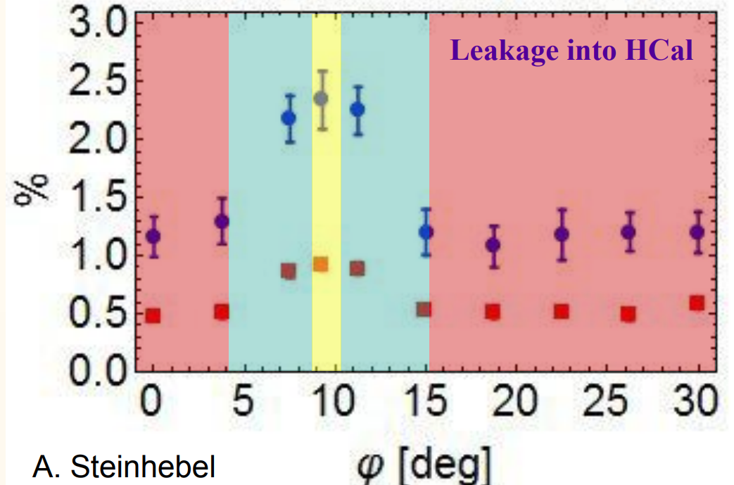
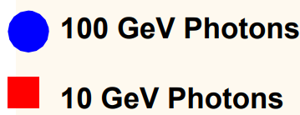
GEOMETRY EFFECTS
Leakage into HCAL in overlap region increases due to less material, phi dependent

Slide 13
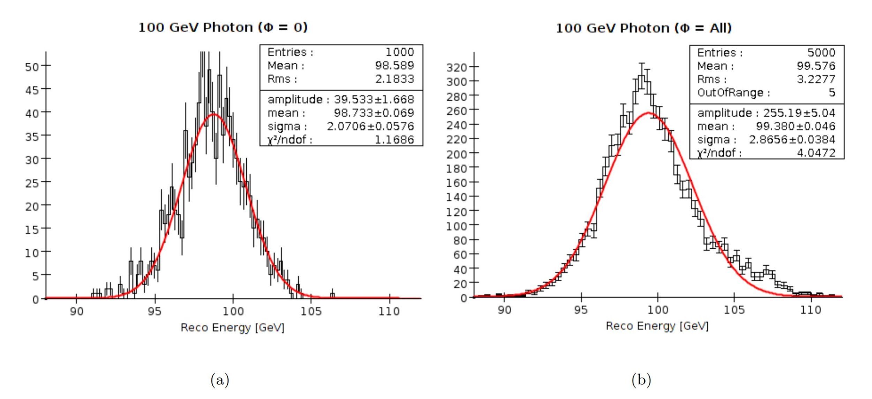
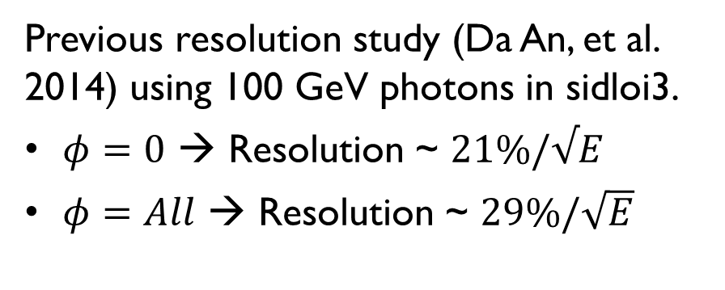
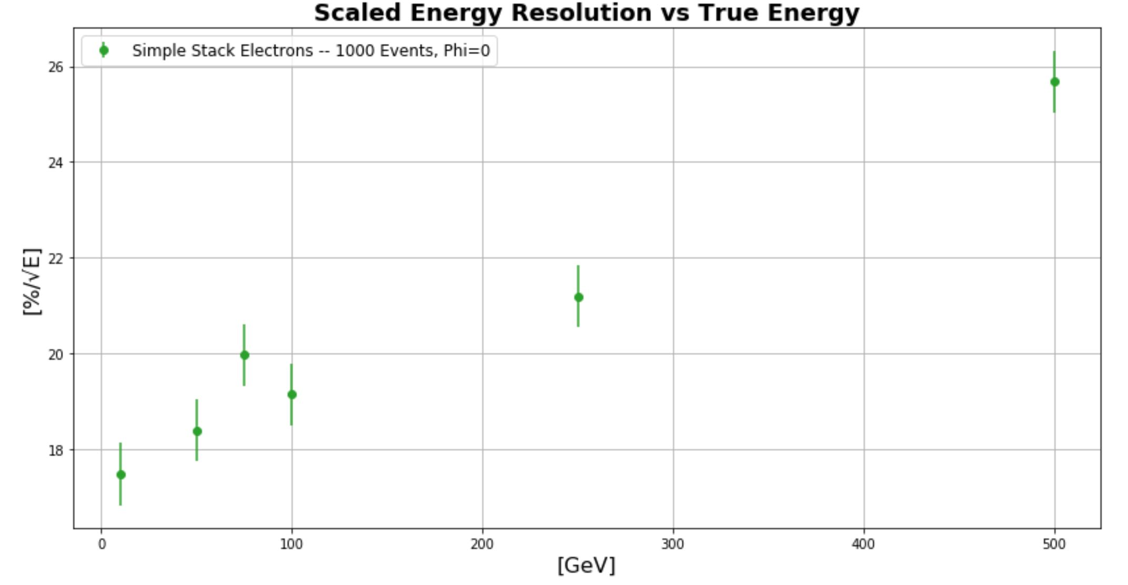
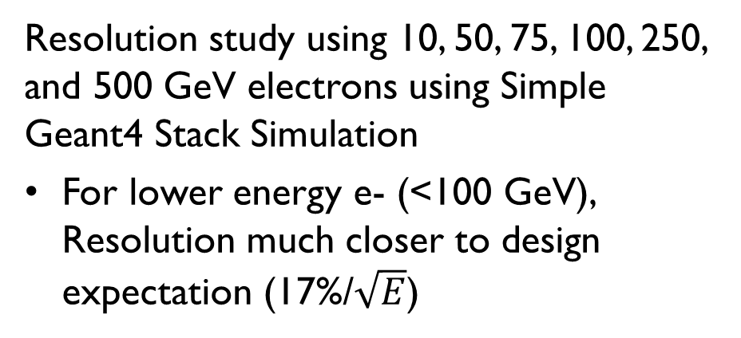
RESOLUTION EFFECTS FROM GEOMETRY
E. Meyer

Slide 14
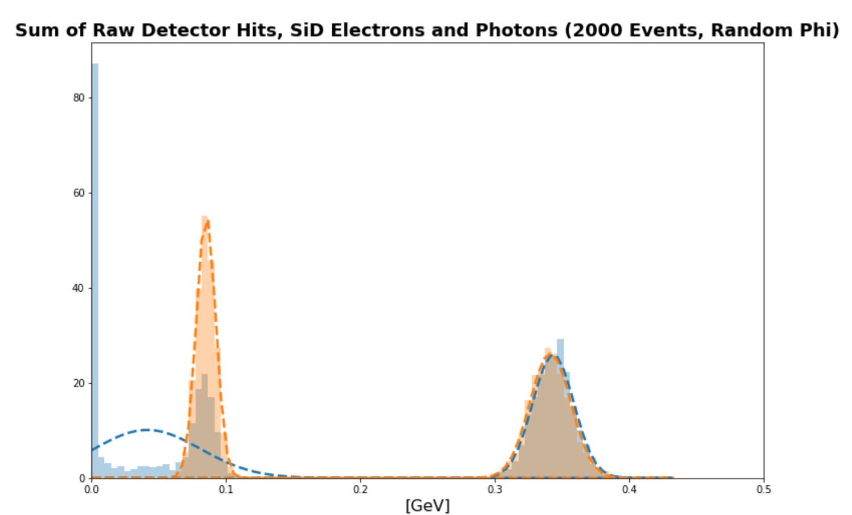
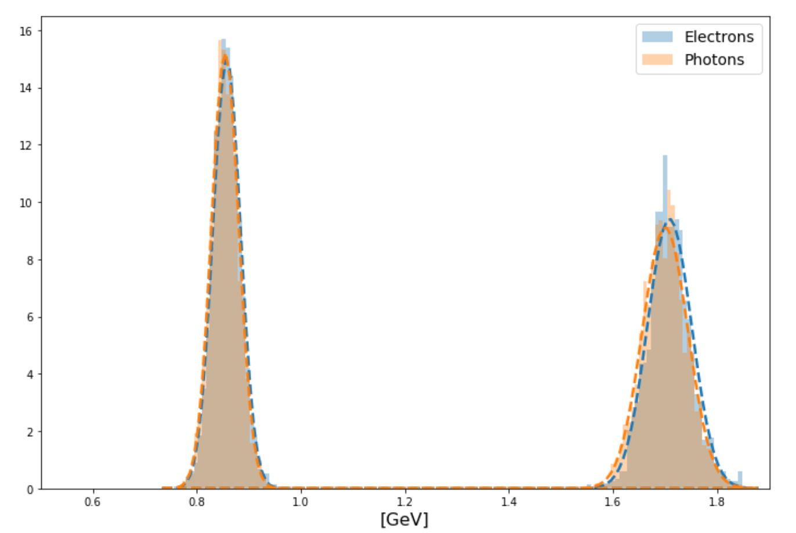
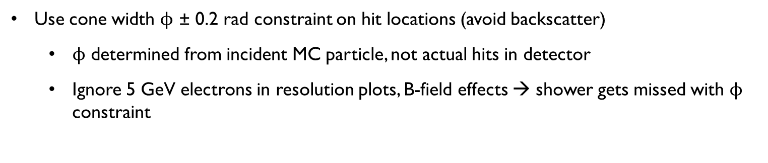
NOTE:
50 GeV
5 GeV
100 GeV
10 GeV

Slide 15
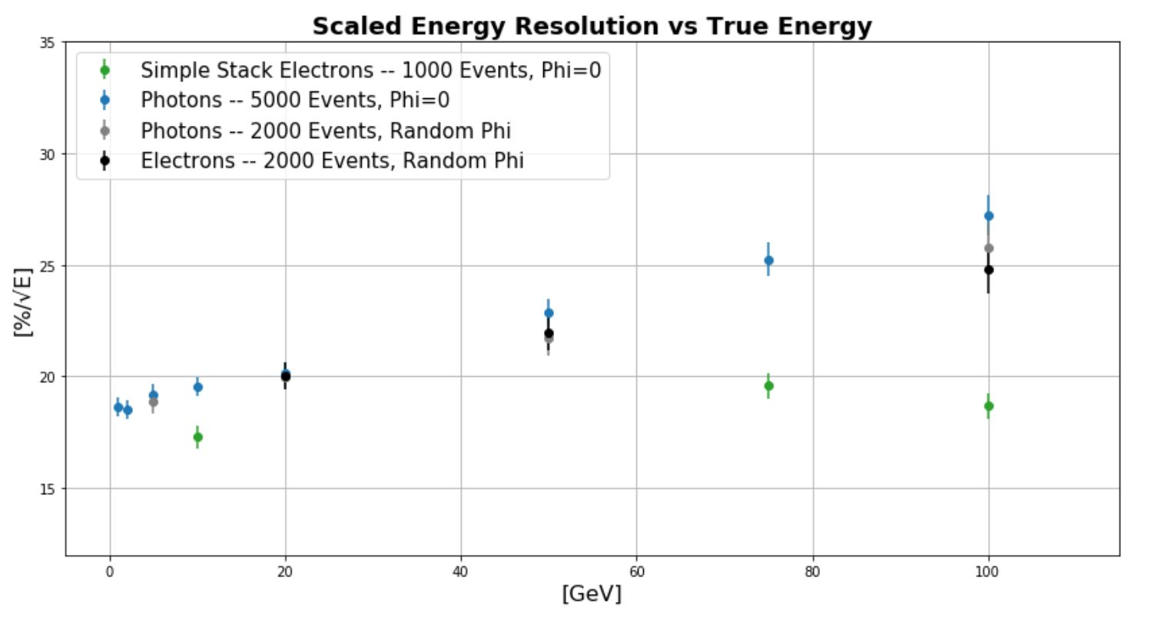
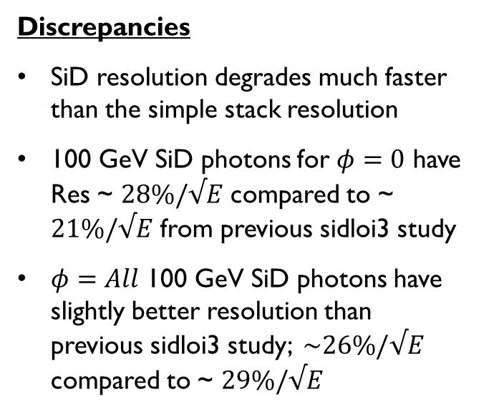
COMPARISONS

Slide 16
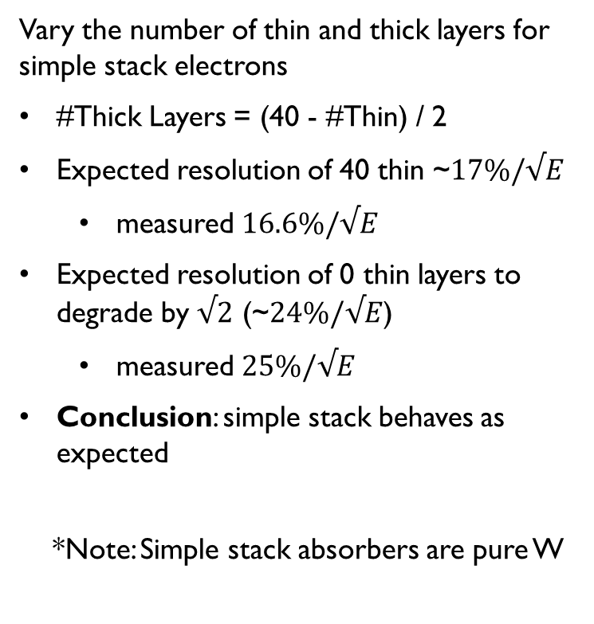
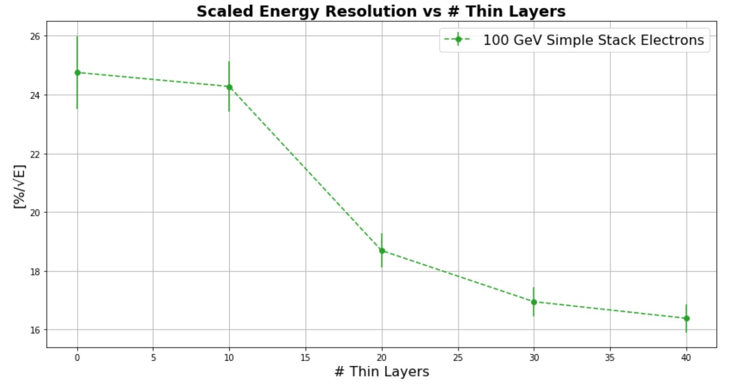
CONFIRM SIMPLE STACK BEHAVES AS EXPECTED

Slide 17
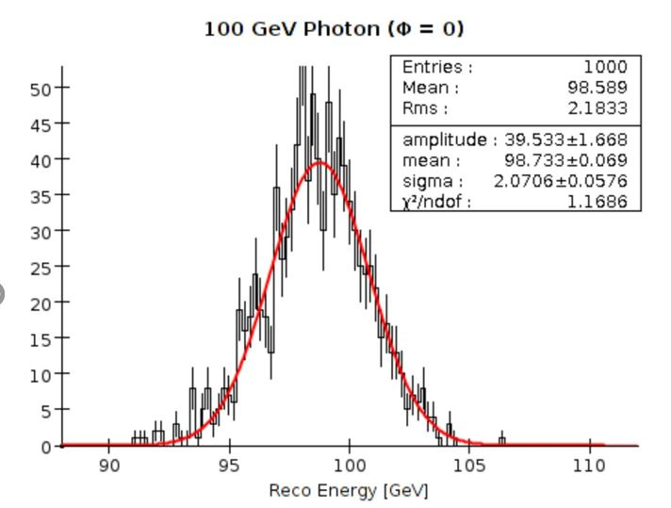
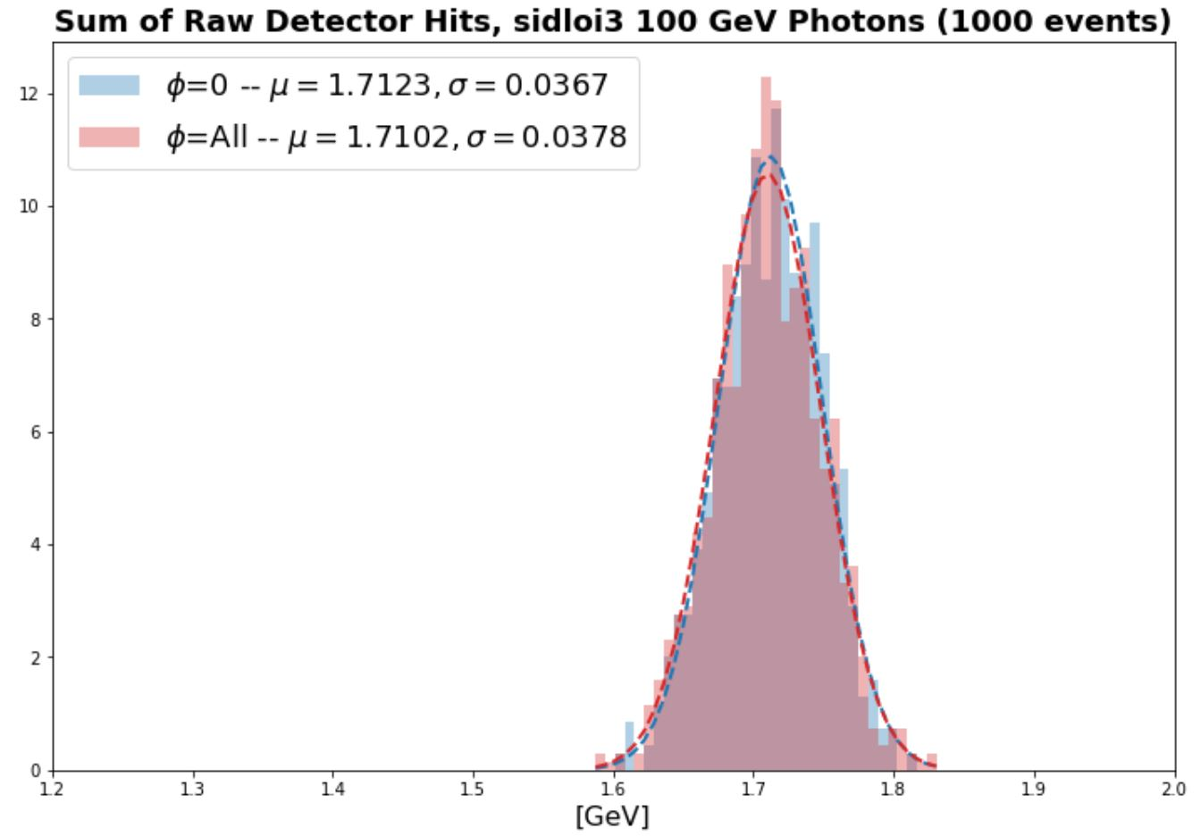
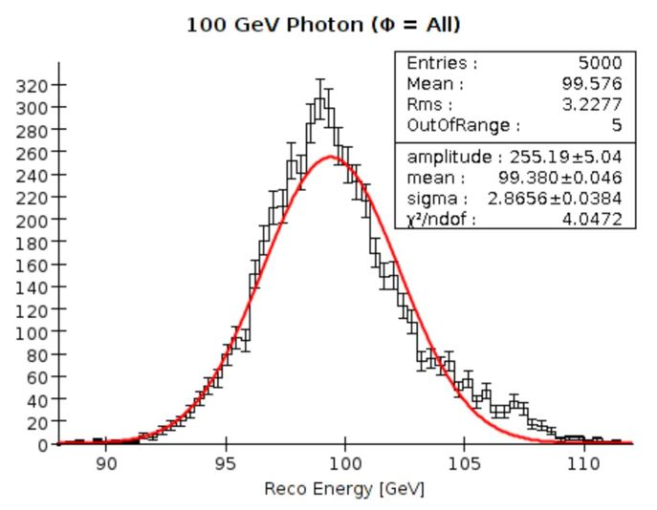
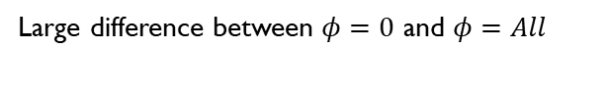
SIDLOI3 RESULTS
Previous study
(Da An, et al.)
Current study →
(what is used on following resolution plot)

Slide 18
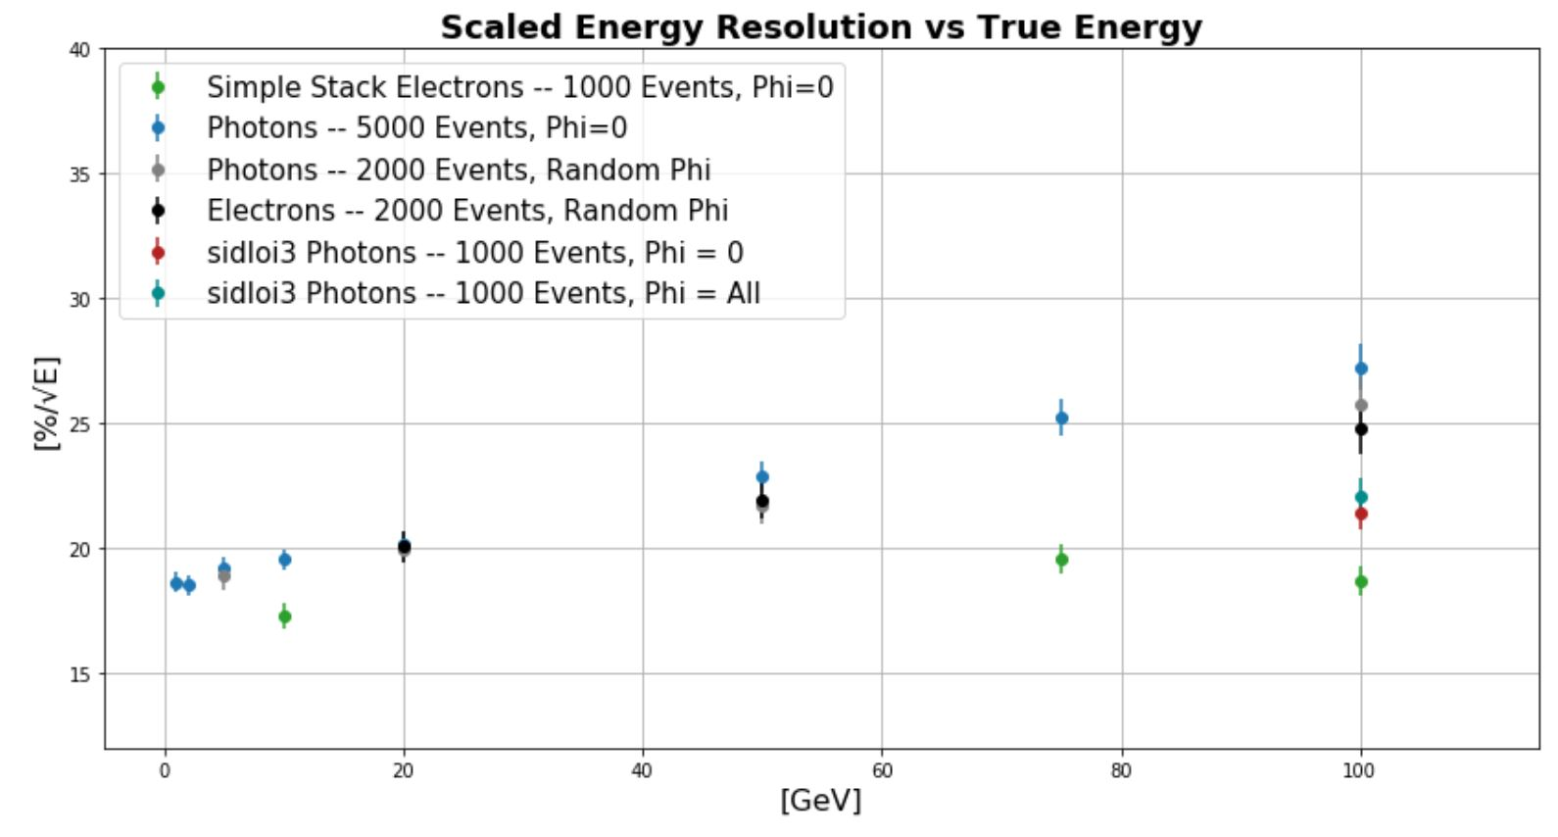
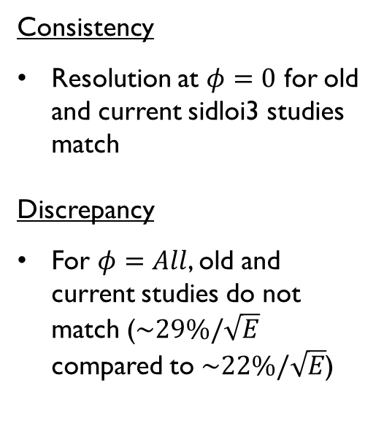
SIDLOI3 RESULTS CONTINUED

Slide 19
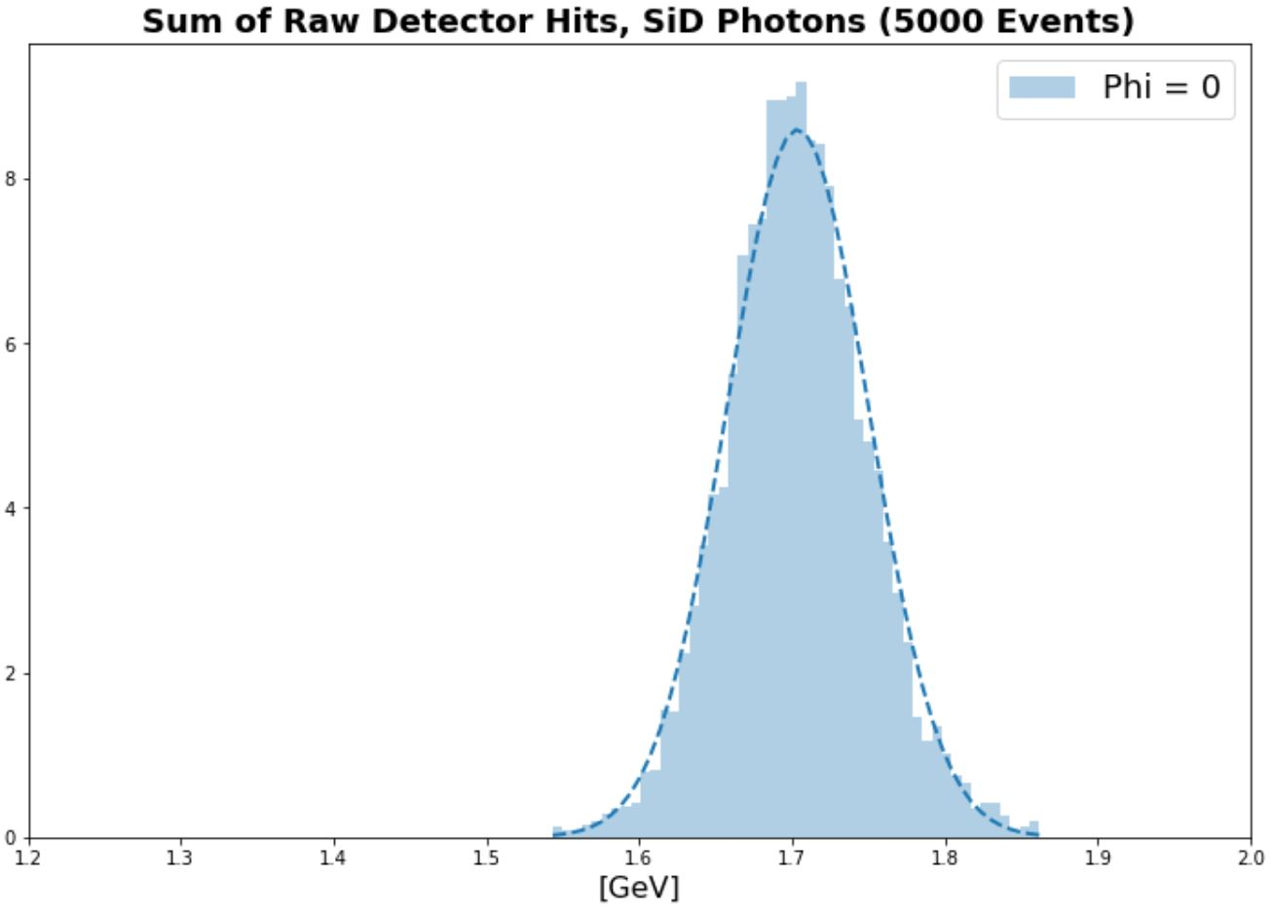
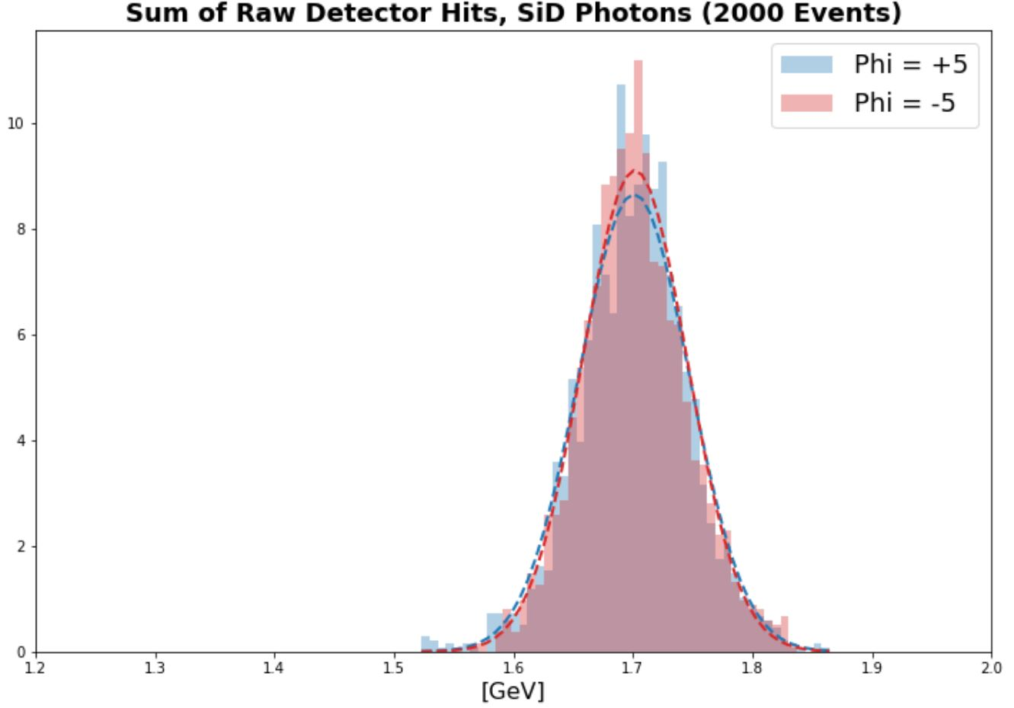
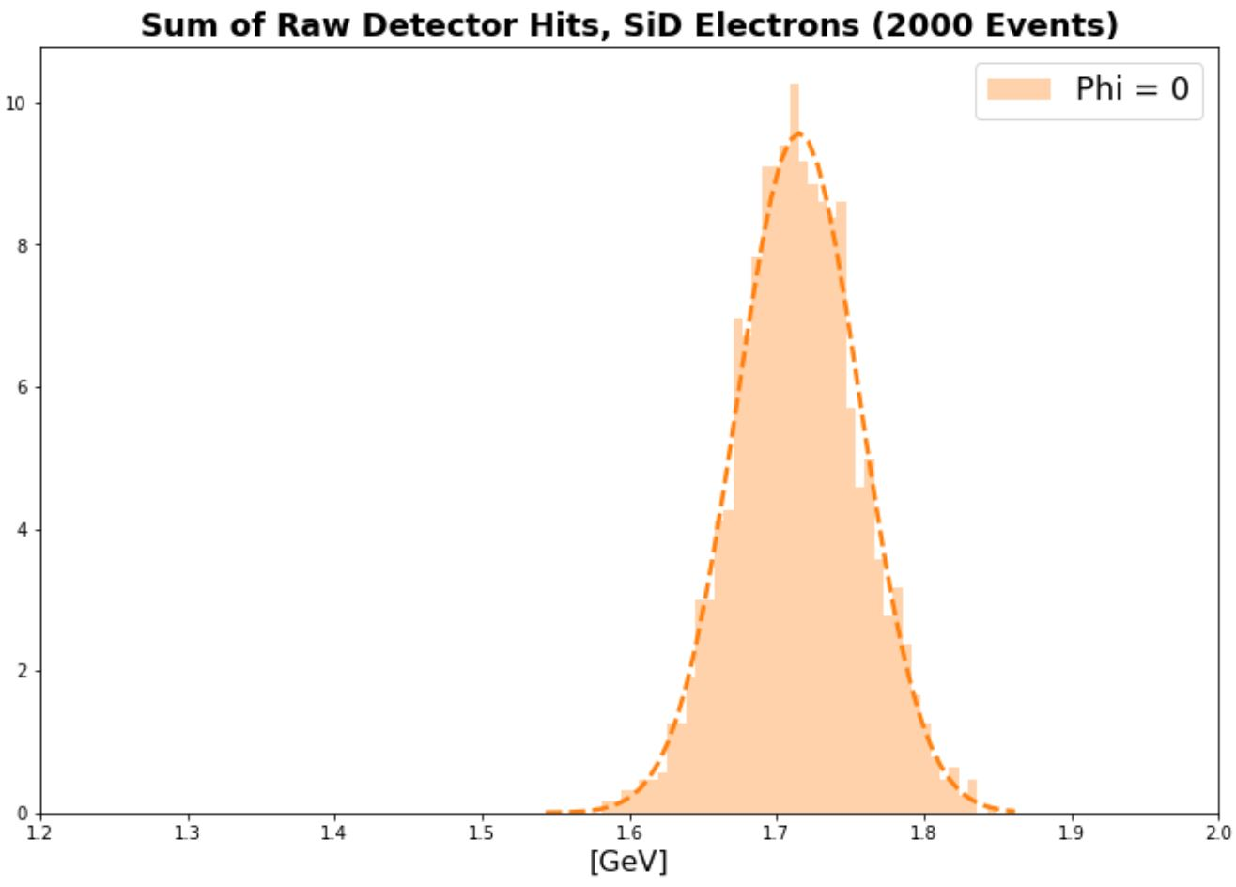
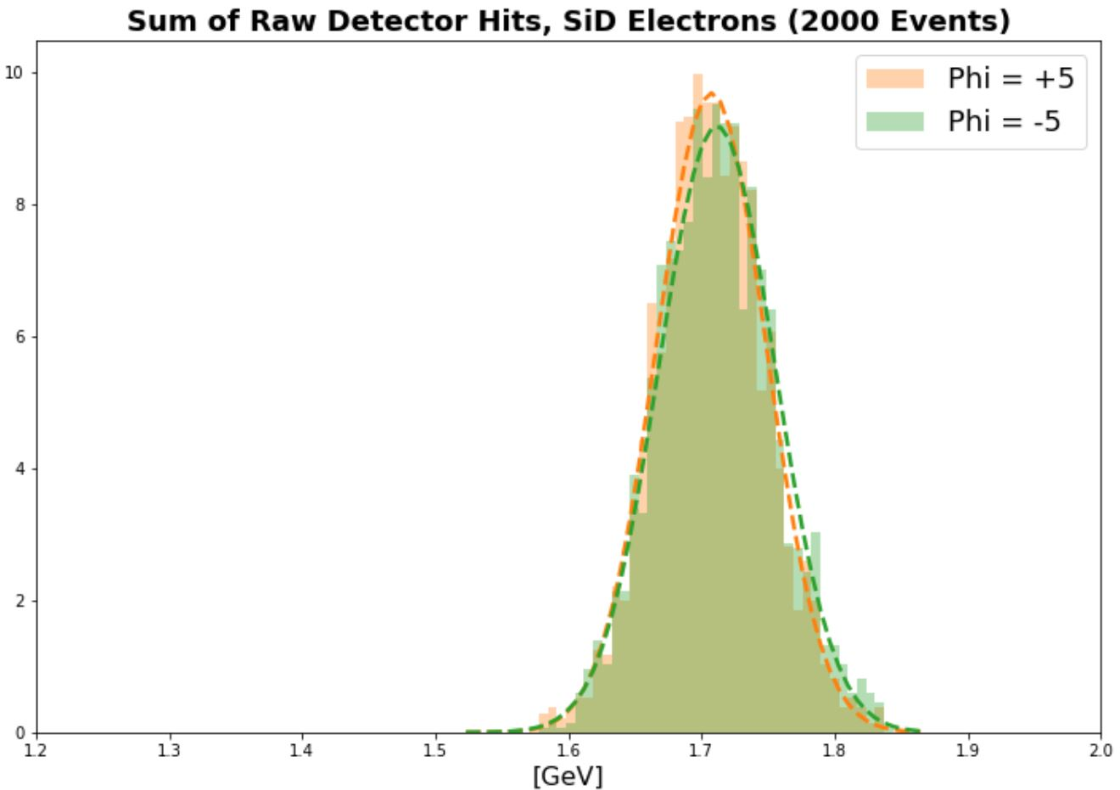
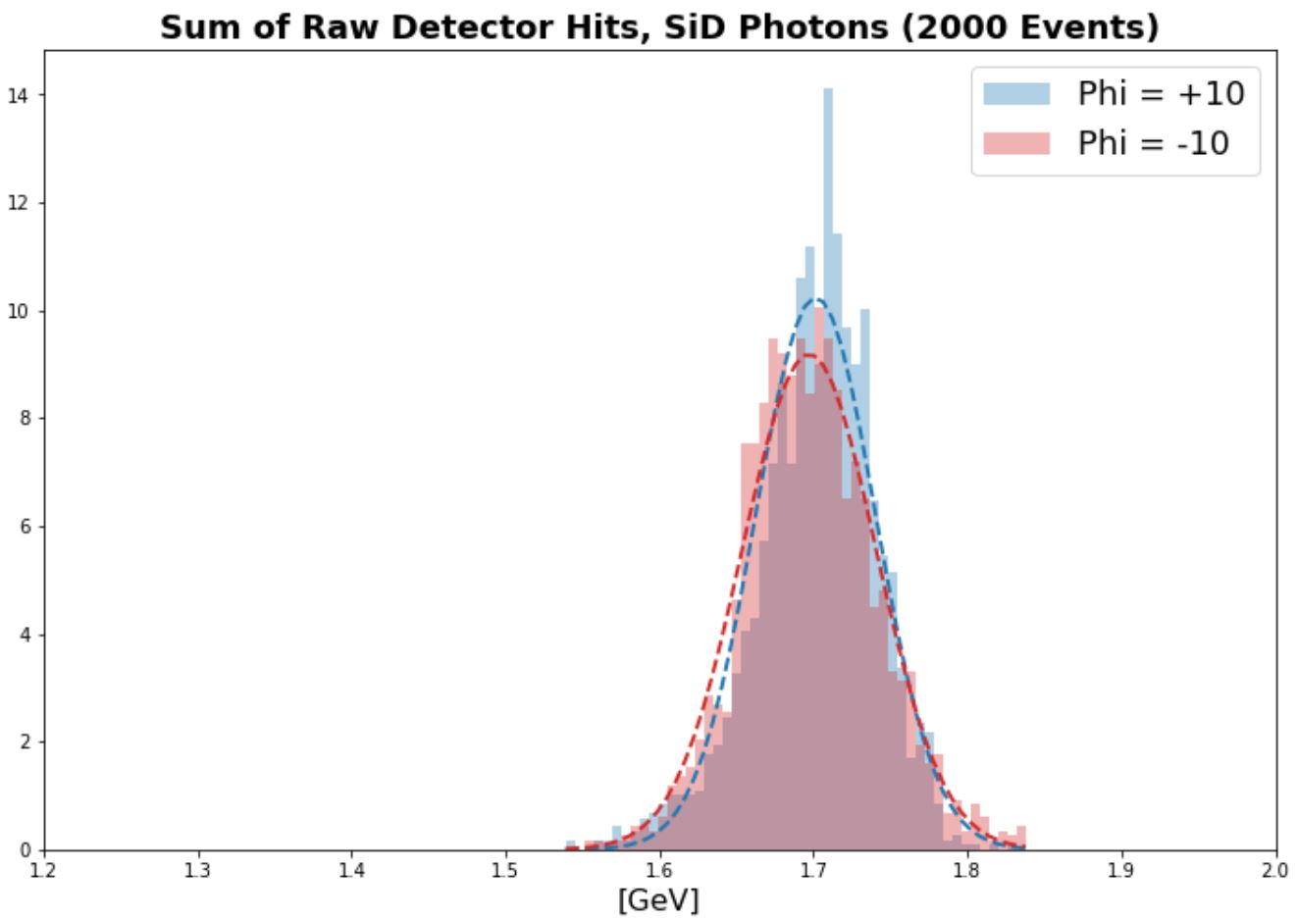
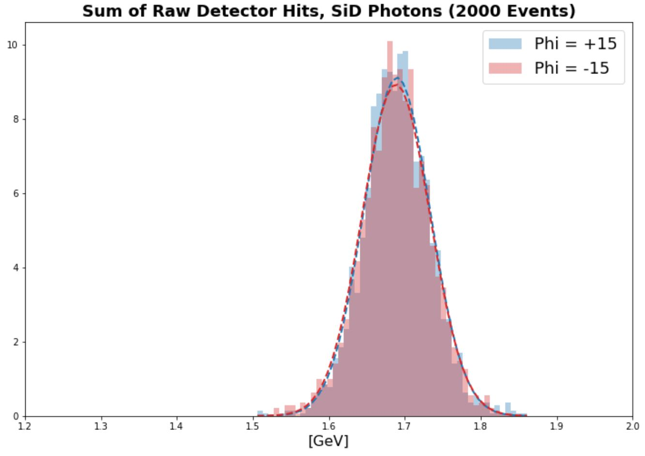
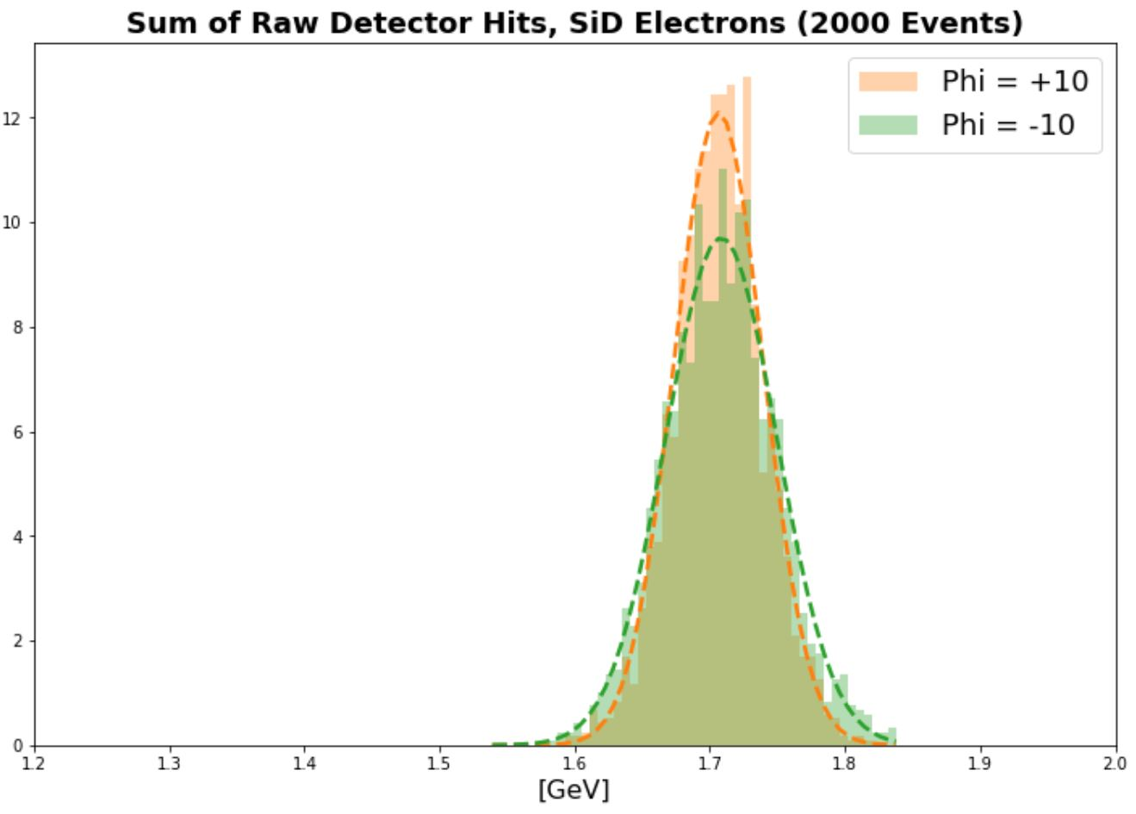
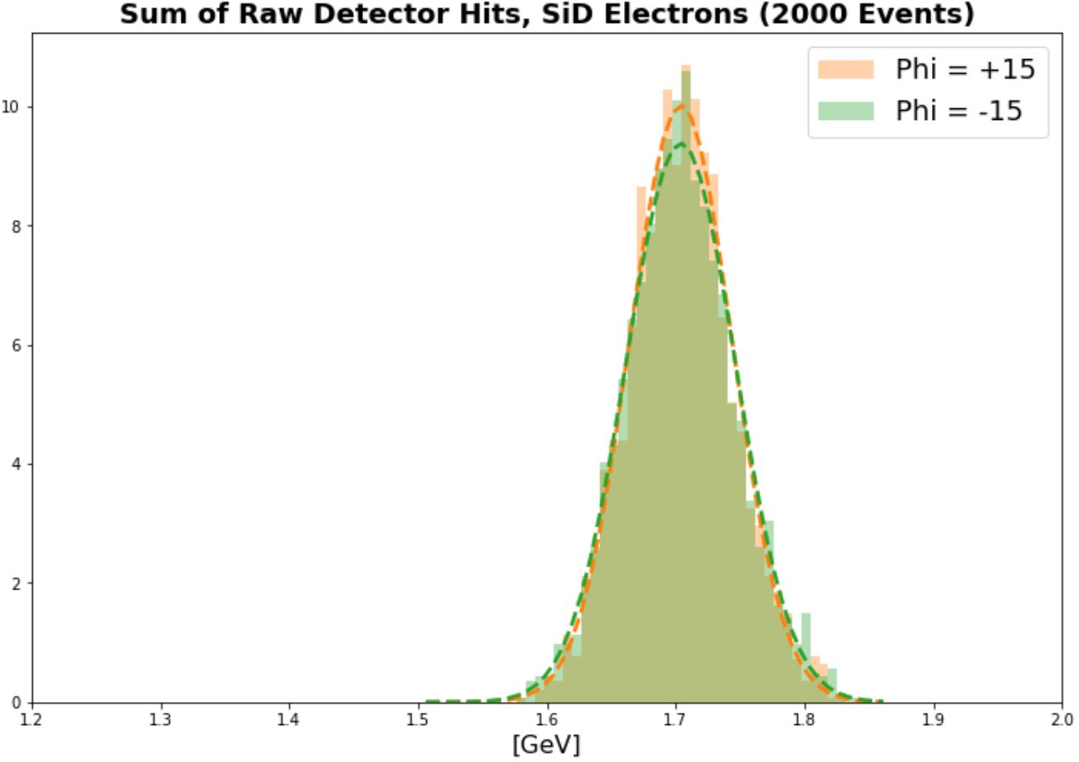
HOW DOES INCIDENT HIT LOCATION IN MODULE AFFECT RESOLUTION?

Slide 20
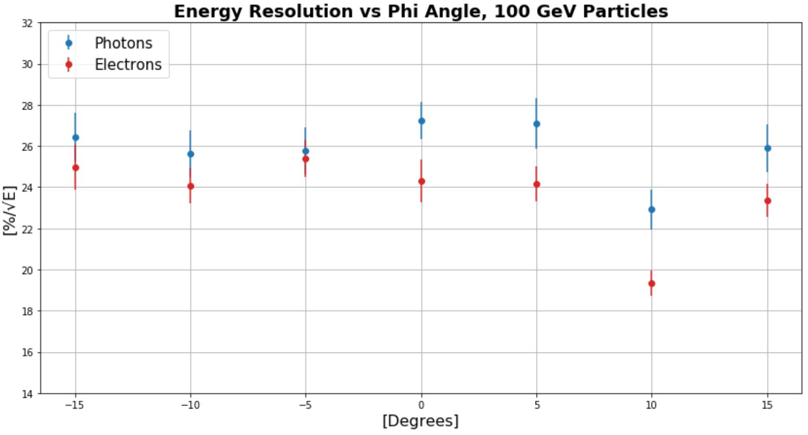
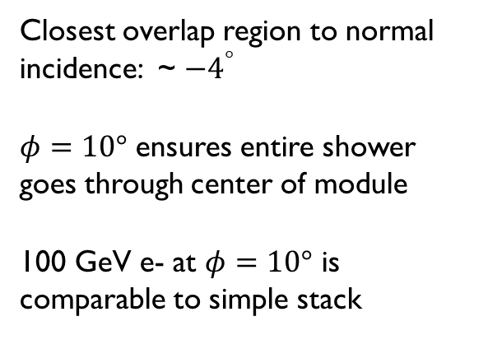

RESOLUTION DEPENDENCE ON PHI

Slide 21


SUMMARY OF CURRENT RESOLUTION RESULTS

Slide 22


LOOKING AT “REAL” EVENTS
Calorimeter hits (EcalBarrelReco, HcalBarrelReco…)
True MCParticle (rho, gamma, pi+)
Electron/Positron
Pandora PFOs

Slide 23


Raw Data
Truth Info
Pandora PFOs

Slide 24

Here we are choosing a certain percent of the rho energy and looking at the cone angle vs. the percent of events that contain the percent of rho energy that was chosen.

Slide 25

Here we are choosing a certain cone angle and looking at the cumulative distribution for how many events get to a certain percent of the rho energy shown on the x-axis. Looking at 100% for 0.15 radians we see that in nearly all the events, the cone contains all the rho energy.

Slide 26
SUMMARY
Better understanding current results more every day
Resolution differences from initial design resolution to current design geometry
Comparison between versions of geometry can be tricky

Slide 27

BACKUP
Distribution of energies in simulation depending on which way the test beam was facing into the detector, small differences

Slide 28


Slide 29


Slide 30


BACKSCATTER

